Slide 1





⥫
VOICE RECOGNITION
B CHAITANYA(E22CSEU0787) SAMEER MISHRA(E22CSEU0813)

Slide 2
⥫
Unlocking the Potential: A Deep Dive into Voice
Recognition Technology

Slide 3






Introduction
An overview | of
technology | and | its | impact | on | various
industries. This presentation will explore the potential and challenges of .

Slide 4





Evolution of Voice Recognition
From early
systems to advanced
, the evolution of technology has been remarkable.

Slide 5






Applications in Healthcare
The use of in healthcare for transcribing medical records, dictating notes, and improving overall is revolutionizing the industry.

Slide 6




Voice-Activated Assistants
The rise of |  |  | like
Siri, Alexa, | and | Google | Assistant
has transformed the way we interact with technology in our daily lives.

Slide 7

Challenges and Limitations
Despite advancements,
technology still faces challenges such as
and
that need to be addressed.

Slide 8
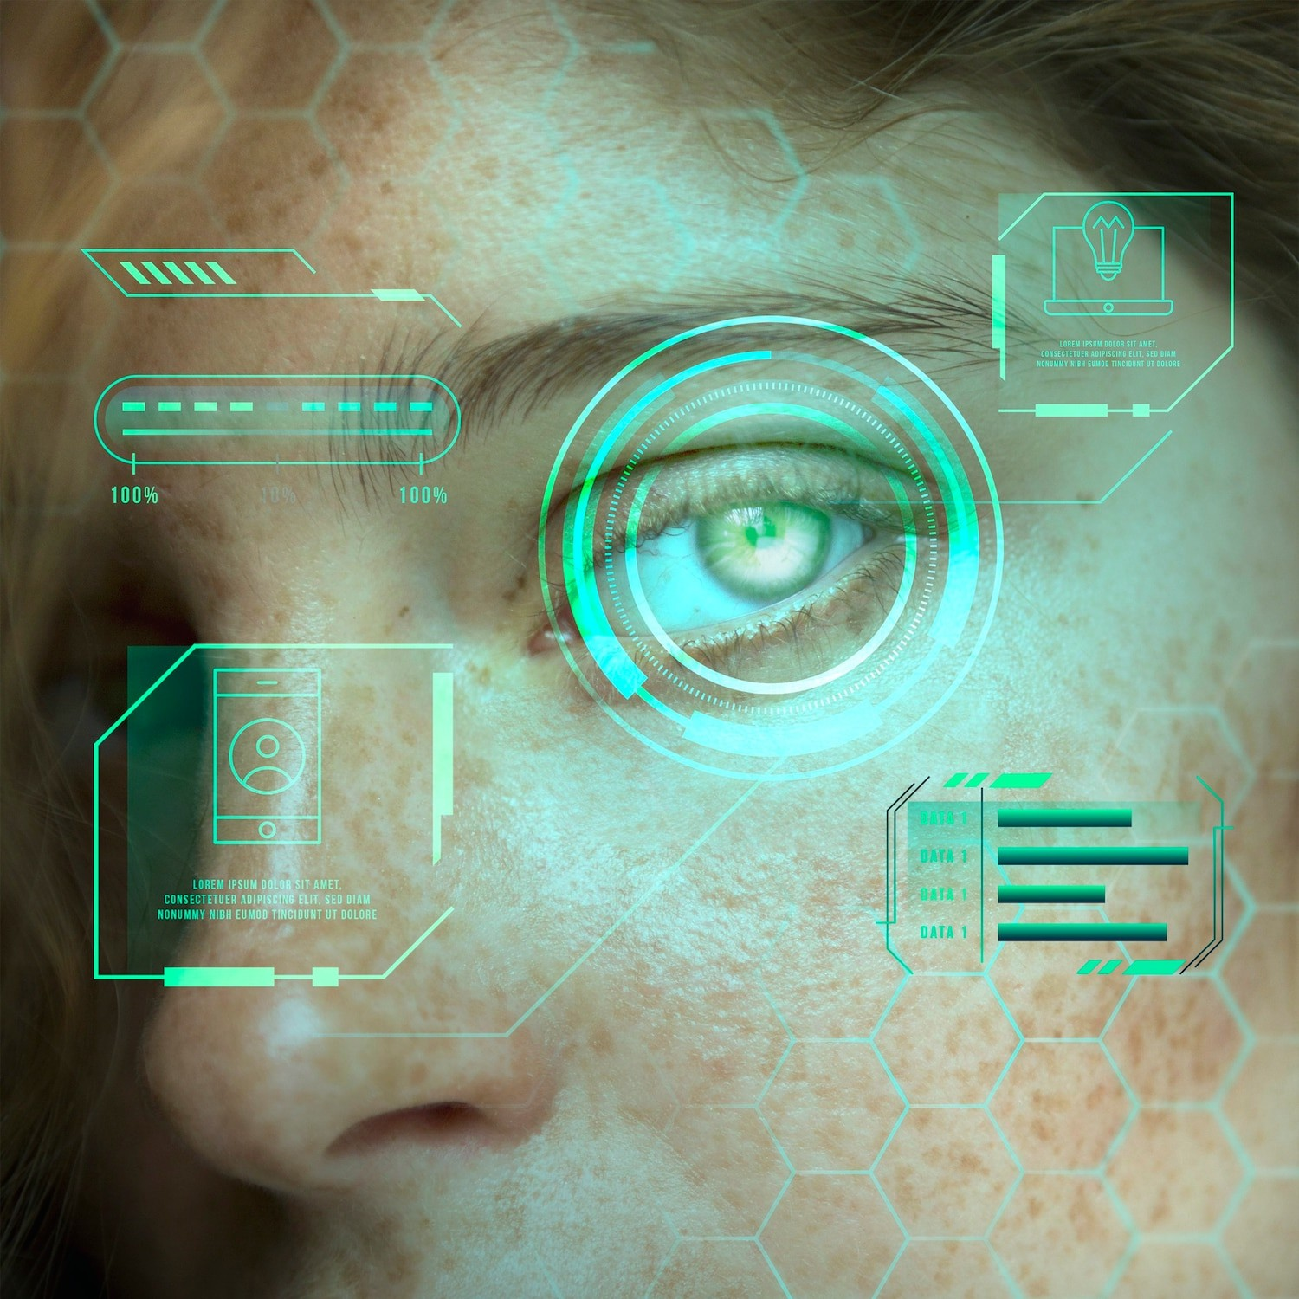
Voice Biometrics
The use of for
secure authentication and fraud prevention is gaining traction in the financial and security sectors.

Slide 9





Voice Recognition in Automotive
Integration of
vehicles for hands-free operation and seamless connectivity is
in
enhancing the driving experience and safety.

Slide 10


Future Trends
The future of advancements in
technology includes
and
to enhance user experience.

Slide 11
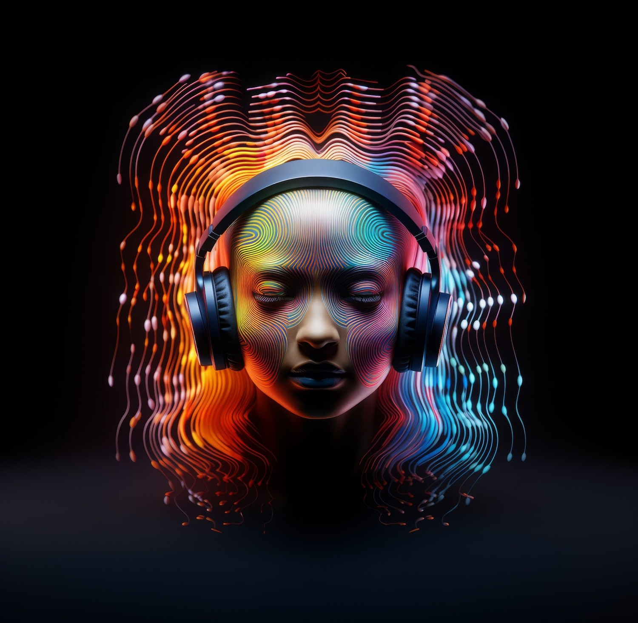

Ethical Implications
As becomes more pervasive, ethical considerations related to and
must be carefully addressed.

Slide 12



Conclusion
In conclusion, technology has the potential to revolutionize various industries, but it also presents challenges that require careful consideration and innovation.

